Slide 1

ISDS 552 GP2
TEAM MEMBERS:
DEEPAM KHIRWAR
HARSHITA DIDWANIA
KAVINDU WALIMUNIGE
SANCHIT SINGH
SATHIYA PRIYA JEEVANANDAN

Slide 2
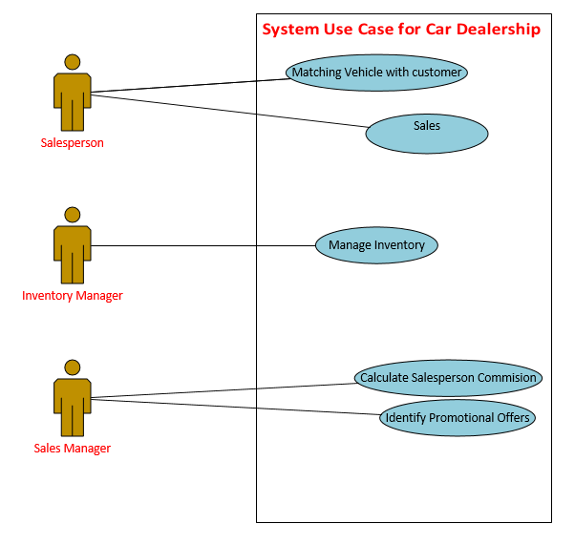
System Use Case Diagram for Car Dealership System

Slide 3
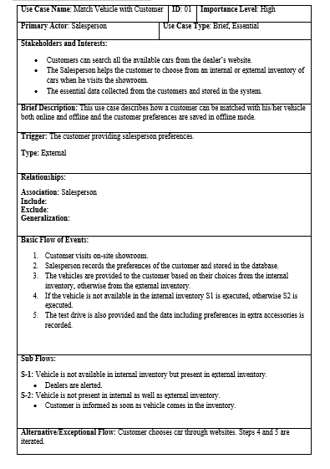
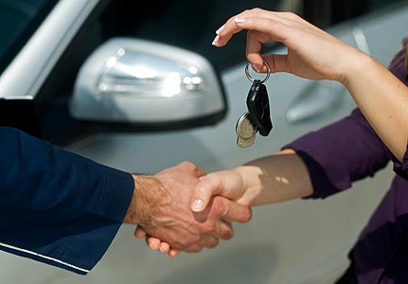
Matching Vehicle with Customers
Use Case

Slide 4
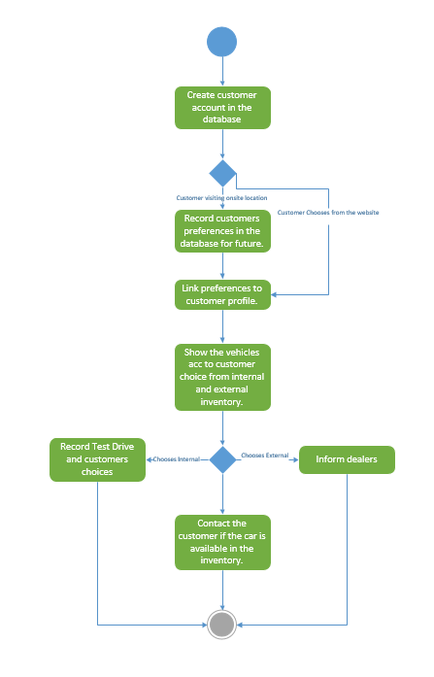
Matching Vehicle with Customers
Activity
Diagram

Slide 5
Sell Car
Use Case

Slide 6
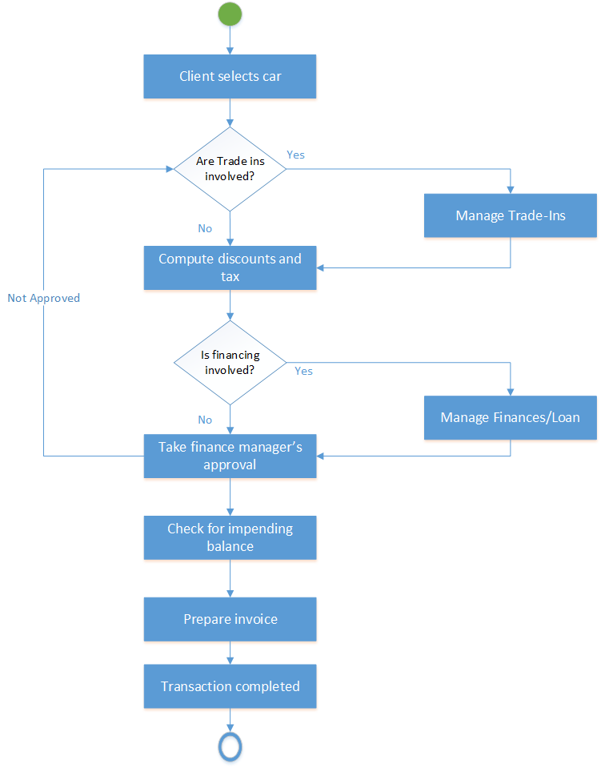
Sell Car
Activity Diagram

